Slide 1
Understanding Childcare Affordability in the U.S.
A Data-Driven Look at Center-Based vs. Family-Based Pricing (2008–2022)
August, 2025
Presented by Zicheng (Chance) Xu
Bellevue University
Summer Term
2025

Slide 2
Content
1
Childcare Cost Trend
2
Childcare Affordability vs Labor Force Participation
3
Regional Cost Disparities
4
Female Childcare Burden by State
5
Female to Male Earnings Ratio Over Time
6
Family-Care Discounts by Age Group
7
Policy Implications & Recommendations

Slide 3
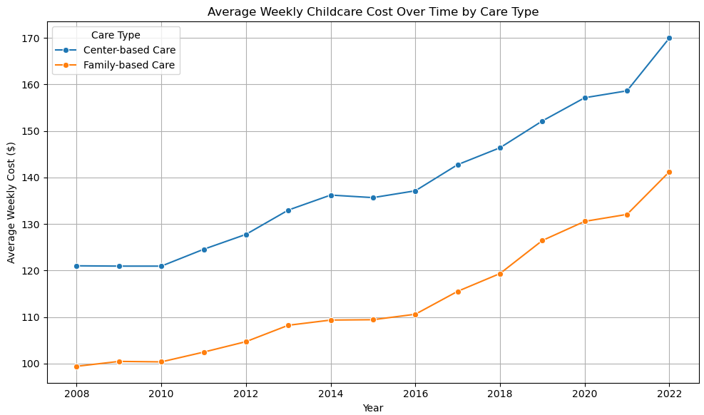
Rising costs of childcare, especially in most recent years, at an increasing speed
Center-based care is more expensive than family-based
Childcare Cost Trend

Slide 4
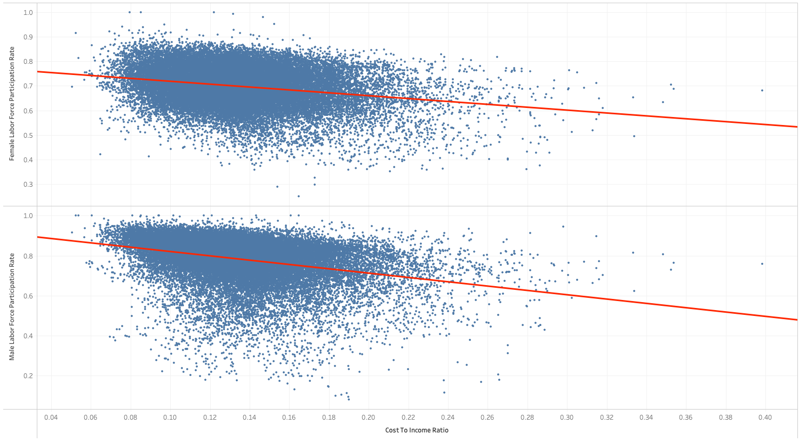
Labor force participation rate has slight negative correlation with Cost-to-income ratio, regardless of gender
Females are less sensitive than males to the Cost-to-income ratio, due to much higher percentage of stay-at-home percentage (26% females vs 7% males, 2021, source)
Childcare Affordability vs Labor Force Participation

Slide 5
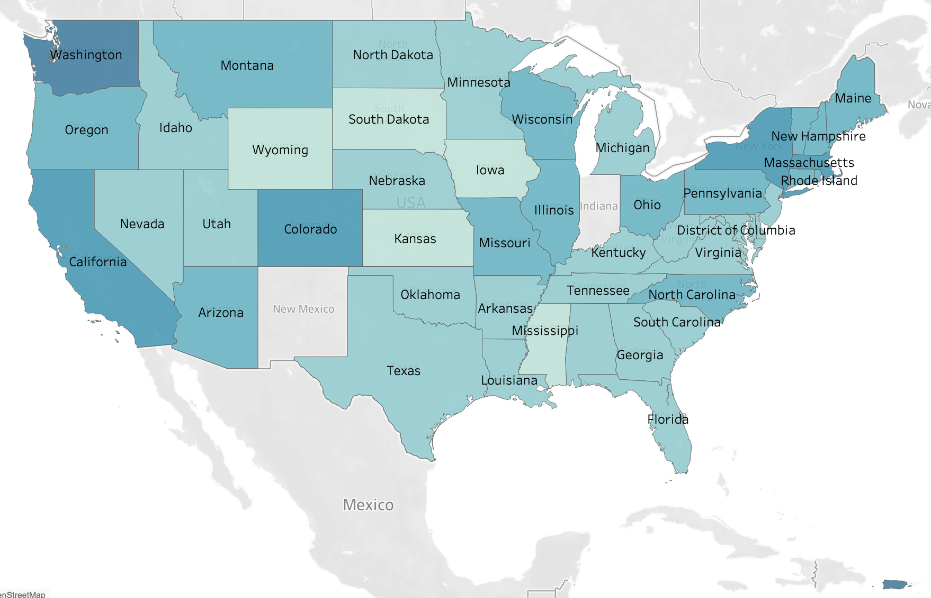
Data shows color scale of Childcare cost-to-Medium Household Income Ratio
The darker the state the costlier the state’s childcare relative to household income
Coastal states, Colorado and Puerto Rico have more pricing burdens
South Dakota, Iowa, Kansas, Wyoming and Mississippi are the cheapest states
Regional Cost Disparities
Puerto Rico

Slide 6
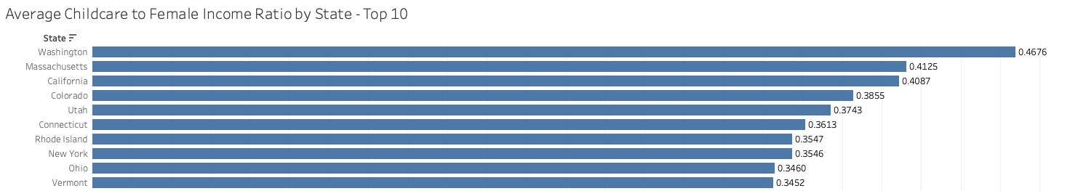
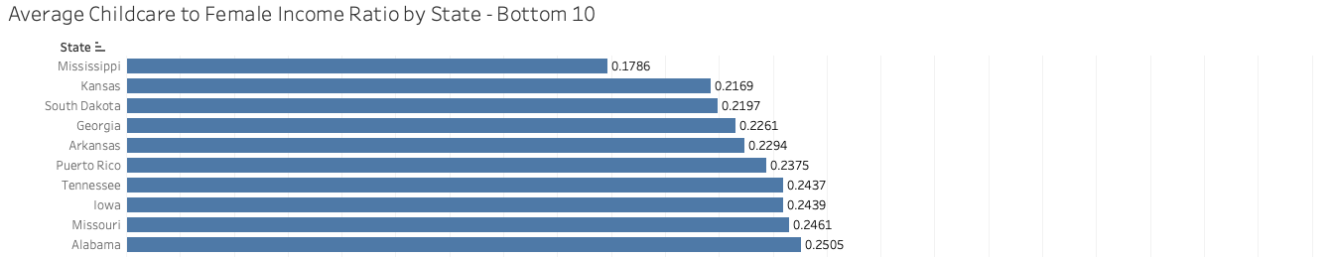
Washington, Massachusetts, and California childcare cost over 40% of annual income for females on average
Even the cheapest state Mississippi cost 18% of annual income for females on average
Female Childcare Burden by State

Slide 7
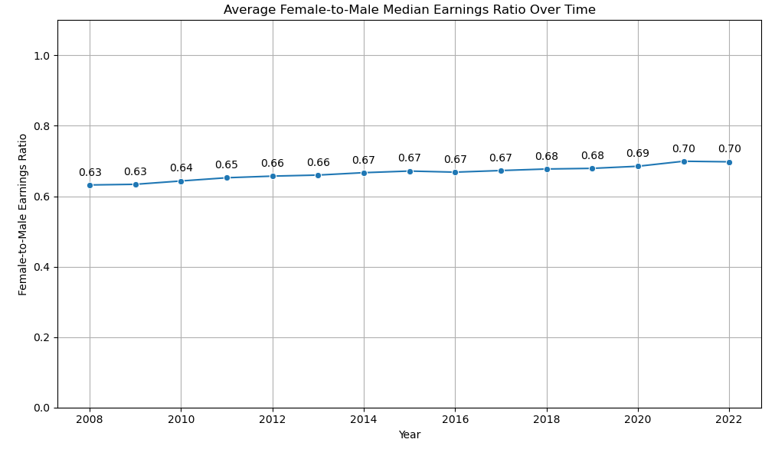
Although females have been making less than males over the studied years on average, the gap is gradually getting narrower, but still with room for improvement to give less price burden to women on childcare
Female to Male Earnings Ratio Over Time

Slide 8
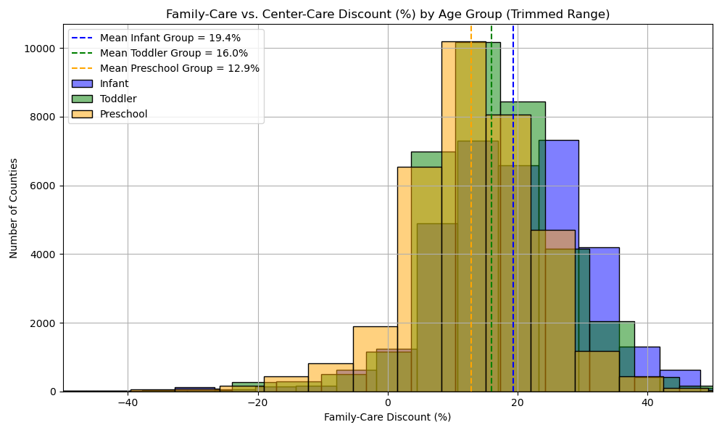
There’s a wide pricing gap among the three age groups for family care discount from center care
Infants are 0-23 months, Toddler 24-35 months, Preschool 36-60 months
Larger discount in infant group encourages families to sign up for family cares, whereas smaller discount in preschool encourages families to choose center cares even though it’s more expensive
Family-Care Discounts by Age Group

Slide 9
Policy Implications & Recommendations
Pricing Gap
Location Balancing
Gender Benefits
Deep Dive Modeling
1
2
Close the pricing gap between center based and family based child cares while advocating and working on improving the quality of family care centers
Focus subsidy and support on most costly counties and states, especially on the coastal areas; Incentivize or expand family-based care in high-cost areas
3
4
Incentivize single-mom families with price discount to close the income inequality between genders
Increase capital expenditure to drive pricing balance among age groups through real-time market demand and supply
Company Name
Quarter Month
Year

